Slide 1
개요
KeyBoardService
MainActivity
키보드 기능 담당
서비스를 통해 다른 애플리케이션에서 MyKeyboard를 사용할 수 있도록 한다.
Package keyboardview, KeyboardInteractionListener
키보드 설정 담당
애플리케이션 실행 시 나타나는 화면으로 사용자로부터 키보드 설정을 입력받는다.
Package setting, FunctionalCustomViewAdapter

Slide 2
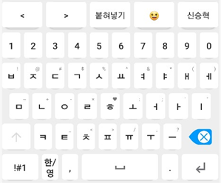
KeyboardService
KeyBoardService
CustomView
사용자 설정
keyboardFrame
KeyboardEnglish
KeyboardKorean
KeyboardChunjiin
KeyboardSimbols
KeyboardEmoji
KeyboardNumPad
HangulMaker
KI
ChunjiinMaker
(Extends HangulMaker)
*KI = KeyboardInteractionListener

Slide 3
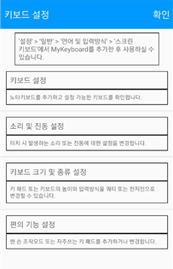
MainActivity
MainActivity
SettingListViewAdapter
Item1
Item2
Item3
Item4
ACTION_INPUT_METHOD_SETTING
SettingDetailActivity
SettingCustomActivity

Slide 4
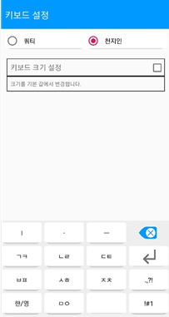
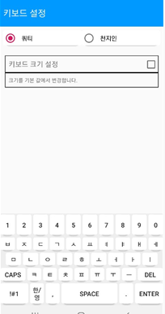
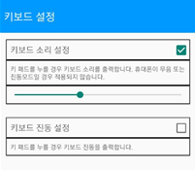
SettingDetailActivity
SettingDetailActivity
RadioGroup
SharedPreferences
(keyboardMode)
SettingRecyclerAdapter
SettingItem
CheckBox
TextView
Seekbar
SharedPreferences
(keyboardSound)
(keyboardVibrate)
(keyboardHeight)
KeyboardView

Slide 5
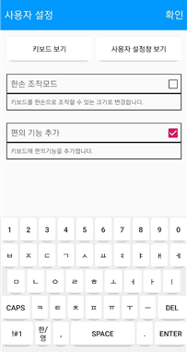
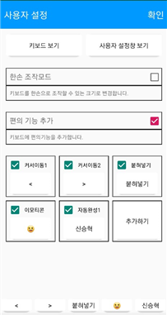
SettingCustomActivity
SettingCustomActivity
ViewWithKeyboardBT
ViewWithCustomViewBT
OneHandItem
SharedPreferences
(CustomViewEnable)
(OneHandMode)
CutomItem
CheckGridView
KeyboardView
CustomItemDBHelper(SQL)
CustomView

